Slide 1
Welcome To:
Module 1
Understanding Linux Concepts

Slide 2



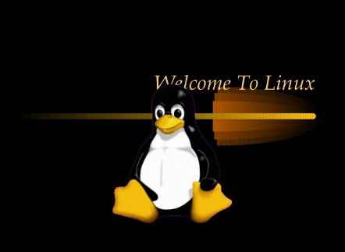


What is Linux?
Linux is an Operating System which sits in the middle of your hardware and users
By: Imran Afzal

Slide 3
Unix vs. Linux
Unix was first developed for multi-user and multi-tasking in mid-1970 in Bell Labs by ATT, GE and Massachusetts institute of Technology
Then born Linux in 1991 by Linus Torvalds
Linux is mostly free
Linux is open source
Unix is mostly used by Sun as Solaris, HP-UX, AIX etc.
Linux is used by many developers community or companies (Redhat, CentOS, Debian) etc.
Unix comparatively supports very fewer File systems
Linux can be installed on a wide variety of computer hardware, ranging from mobile phones, tablets, video game consoles, to mainframes and supercomputers.
By: Imran Afzal

Slide 4
114 Linux Commands
By: Imran Afzal

